Slide 1
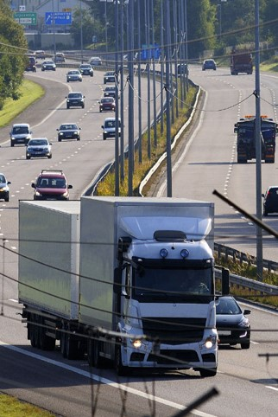
E-services tutorial
- How to report hazardous waste
This is a step-by-step tutorial on reporting hazardous waste to the waste register maintained by the Swedish Environmental Protection Agency.

Slide 2
Copyright notice to imagery
Photographic imagery in this presentation cannot be copied to or used in other presentations.
The copyright only applies to this presentation.

Slide 3
Step 1 log in

Slide 4
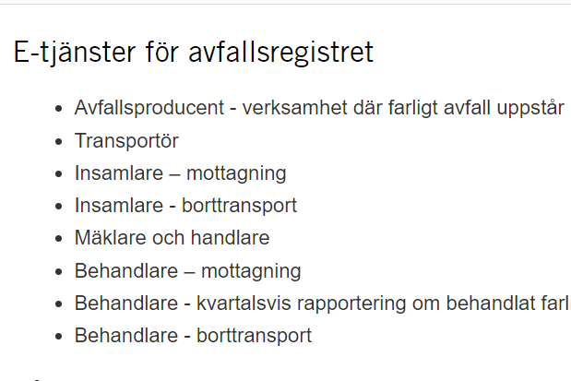
www.naturvardsverket.se/avfallsregister
(e-services for the waste register)
The easiest way to access the waste register is via:
www.naturvardsverket.se/
avfallsregister
Select the entry:
”Behandlare - borttransport”
”Waste treatment facility – reporting at removal”

Slide 5

To access the e-service
To complete the login and access the e-service, you need to identify yourself with an e-identification.

Slide 6
Step 2 first questions

Slide 7
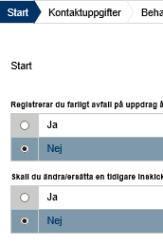
Start=First
The first step is to submit answers to identify if you are reporting as an agent, want to change a previously submitted document or if the waste is produced outside Sweden's border.
An agent is authorized to bring an action for another person.

Slide 8
Step 3 contact details

Slide 9
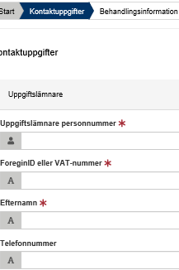
Contact details
Some details about you is filled in automatically and can’t be changed.
Submit details about the company/business you represent.
See example on next page.

Slide 10

Example with contact details
Uppgiftslämnare (Provider)
Uppgiftslämnares personnummer: * Provider’s social security number
19660916-1689
Operators in this note treat hazardous waste. In other notes, operators are producers of hazardous waste, performers who professionally ship, collect, or act as dealers and brokers of hazardous waste
Förnamn: * First name
Efternamn: * Surname
Sune
Degernan
E-postadress: * E-mail
Telefonnummer : * Telephone
sune.degerman@avaretur.se
070-345 67 82
Verksamhetsutövare (Operator)
Organisationsnummer/personnummer: * Organization number/social security number
578654-3214
Verksamhetens namn: * Name of the company
Kontaktperson: * Contact person
ÅVA Retur AB
Tova Strand
E-postadress: * E-mail
Telefonnummer: * Telephone
tova.strand@avretur.se
072-321 45 78

Slide 11
Step 4 transportation details
Notes:
Nästan samma som för insamlare men steget handlar om borttransport.

Slide 12
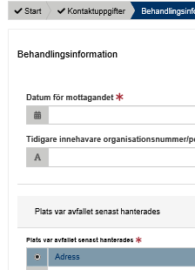
Transportation details
Here, details must be provided in two areas:
Details about the removal
Place where the waste will be received
Examples on the following pages.

Slide 13

Provide information: transportation details
- Waste treatment
Behandling Waste treatment
The legal person who receives the hazardous waste after shipment has been completed.
For example, a waste handler or waste dealer.
Datum för borttransport: * Date of removal
2020-10-29
Mottagarens organisationsnummer/personnummer: * The consignees’ organization number
553654-4323
Transportörens organisationsnummer/personnummer: * The carrier's organization number / social security number
556234-5677
Transportsätt: * Transportation
Vägtransport

Slide 14
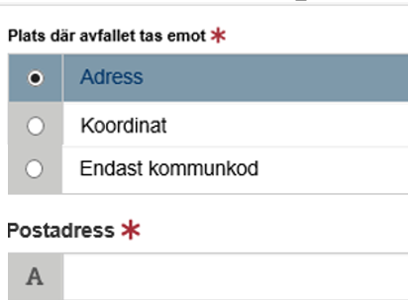
Provide information: transportation details
- Destination. Option 1 if address exists.
The destination for the waste is where a new holder takes over the responsibility for the hazardous waste.
If address is missing, enter coordinates or municipality code.

Slide 15
Step 5 waste details

Slide 16
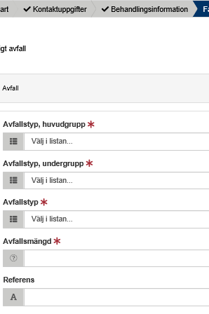
Hazardous waste
All details about the waste must be provided, such as the waste classification code and the amount of waste.
See example on next page.

Slide 17

Example of hazardous waste details
The waste classification codes are from the Waste Regulation (2020: 614) Read an introduction to waste classification
Farligt avfall, avfall Hazardous waste, waste
Avfallstyp, huvudgrupp: * Waste classification code, main group
15 Förpackningsavfall, absorbermedel, torkdukar, fibermaterial och skyddskläder som inte anges på annan plats
Avfallstyp, undergrupp: * Waste classification code, sub group
1501 Förpackningar (även kommunalt förpackningsavfall som samlats in separat)
Avfallstyp: * Waste classification code, six digit code
Here, the waste treatment
can e.g. enter an own code for the waste. Free comment.
150111 Metallförpackningar som innehåller en farlig, fast, porös fyllning (t.ex. asbest), även tomma tryckbehållare
Avfallsmängd (kg ):* Amount of waste in kilogram
KG
765,5
Referens: Reference
Valfri text

Slide 18
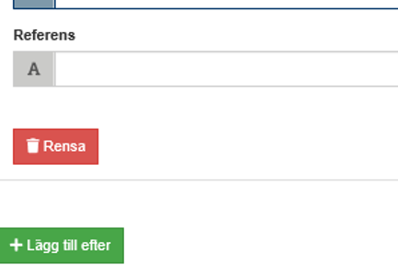
Add more hazardous waste
Select “Lägg till efter“ to add information about other hazardous waste that will be removed in the same transport.

Slide 19
Step 6 summary & review

Slide 20
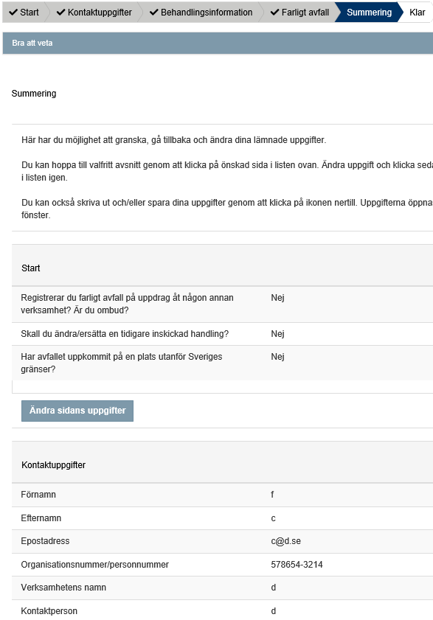
Summary
Review the information.
You can reach different sections to change details by selecting “Ändra sidans uppgifter”.
After changing details in a previous section, you can go directly to this summary.

Slide 21
Step 7 almost done!

Slide 22
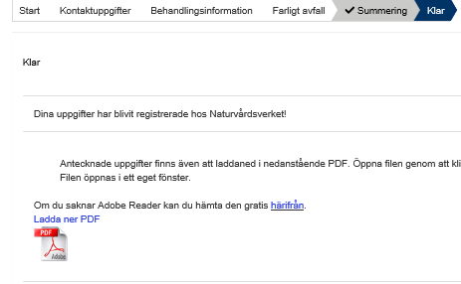
The note is submitted
Thank you for your registration
Keep the registration ID, AvfallsID (found in the pdf file), to be able to revise the registration later.
Log out of the e-service

Slide 23
How do I change an earlier registration?

Slide 24
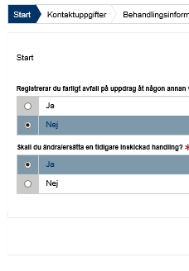
Start
You can edit a submitted note by replacing it. To succeed you need to know the note’s registration ID (avfallsID).
Select “ja“ (yes) at the Start question “Ska du ändra/ersätta en tidigare inskickad handling?”
Enter the former “avfallsID” and enter all correct details
The new note replaces the previous one and gets a new registration ID (avfallsID)
See example on next page.

Slide 25
Example of replacing a previous note
Farligt avfall, avfall Hazardous waste, waste
The waste classification codes are from the Waste Regulation (2020: 614) Read an introduction to waste classification
AvfallsId som ska ändras: * Registration ID to be replaced
b37bafb7-e81a-4a2d-86b0-7d24bfea7c42
Avfallstyp, huvudgrupp: * Waste classification code, main group
15 Förpackningsavfall, absorbermedel, torkdukar, fibermaterial och skyddskläder som inte anges på annan plats
Avfallstyp, undergrupp: * Waste classification code, sub group
1501 Förpackningar (även kommunalt förpackningsavfall som samlats in separat)
Avfallstyp: * Waste classification code, six digit code
150111 Metallförpackningar som innehåller en farlig, fast, porös fyllning (t.ex. asbest), även tomma tryckbehållare
Avfallsmängd (kg): * Amount of waste in kilogram
Here, the waste treatment can e.g. enter an own code for the waste. Free comment.
KG
765,5
Referens: Reference
Valfri text

