Slide 1
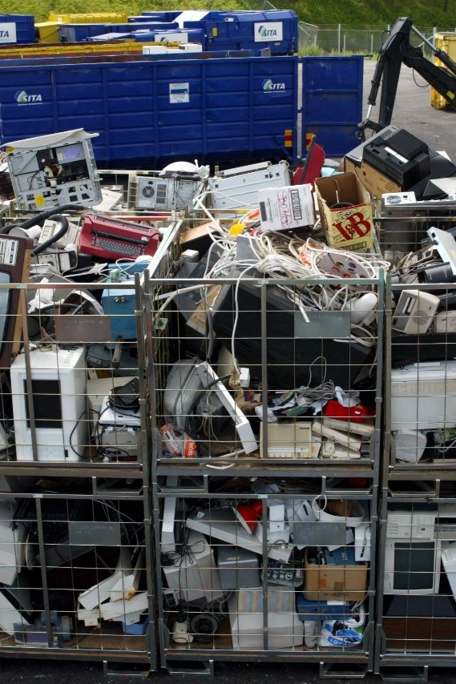
E-services tutorial
- How to report hazardous waste
This is a step-by-step tutorial on reporting hazardous waste to the waste register maintained by the Swedish Environmental Protection Agency.

Slide 2
Copyright notice to imagery
Photographic imagery in this presentation cannot be copied to or used in other presentations.
The copyright only applies to this presentation.

Slide 3
Step 1 log in

Slide 4
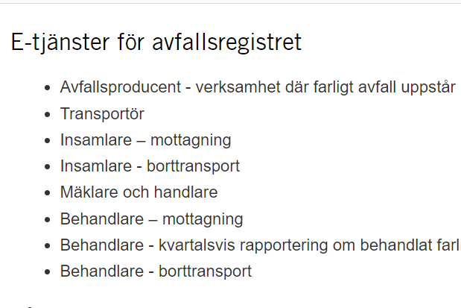
www.naturvardsverket.se/avfallsregister
(e-services for the waste register)
The easiest way to access the waste register is via:
www.naturvardsverket.se/
avfallsregister
Select the entry:
”Insamlare - mottagning”
”Collector – reporting as a consignee”

Slide 5

To access the e-service
To complete the login and access the e-service, you need to identify yourself with an e-identification.

Slide 6
Step 2 first questions

Slide 7
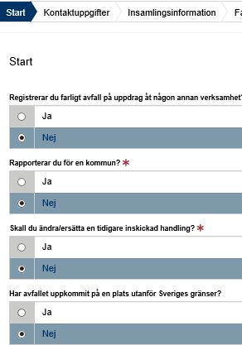
Start=First
The first step is to submit answers to identify if
you are reporting as an agent
want to change a previously submitted document.
the transport starts outside the Swedish border or
hazardous waste comes directly from households
An agent is authorized to bring an action for another person.

Slide 8
Step 3 contact details

Slide 9
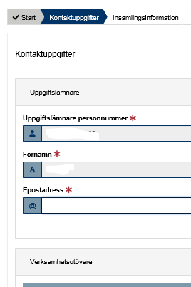
Contact details
Some details about you is filled in automatically and can’t be changed.
Submit details about the company/business you represent.
See example on next page.

Slide 10


Example with contact details
Uppgiftslämnare (Provider)
Uppgiftslämnares personnummer: * Provider’s social security number
19631221-6861
Operators in this note are collector’s of hazardous waste. In other notes, operators are producers of hazardous waste, performers who professionally ship or treat hazardous waste, or act as dealers and brokers of hazardous waste
Förnamn: * First name
Efternamn: * Surname
Gustav
Krantz
E-postadress: * E-mail
Telefonnummer: * Telephone
gustav.krantz@samlain.se
070-456 78 94
Verksamhetsutövare (Operator)
Organisationsnummer/personnummer: *
Organization number/social security number
555678-3578
Verksamhetens namn: * Name of the company
Kontaktperson: * Contact person
SamlaIn AB
Karin Olsson
E-postadress: * E-mail
Telefonnummer: * Telephone
karin.olsson@samlain.se
072-238 79 092

Slide 11
Step 4 consignee details

Slide 12
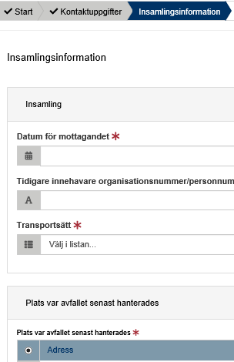
Consignee details
Here, details must be provided in three areas:
Consignment details
Place where the waste was managed last
Place where the waste will be further managed
Examples on following pages.

Slide 13
Provide information as a consignee
- Collection
Insamling Collection
The legal person who previously held the hazardous waste.
For example, a waste producer
Datum för mottagandet: * Date of receivement
2020-10-07
Tidigare innehavare organisationsnummer/personnummer: *
Previous holder’s organization number
2120000365
Transportsätt: * Transportation
Vägtransport

Slide 14
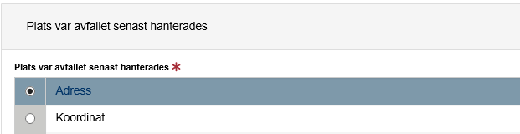
Provide information as a consignee
- Place where the waste was managed last. Option 1 if address exists
Postadress: * Postal address
Västervikstorget 3
Postnummer: * Zip code
Postort: * Post office
64530
Strängnäs
Kommun: * Municipality
Strängnäs (0486)

Slide 15
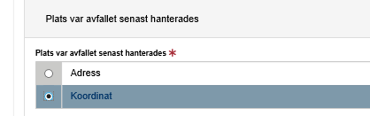
Provide information as a consignee
- Place where the waste was managed last. Option 2 if address is missing - enter coordinates
Nordkoordinat (SWEREF 99 TM):* North coordinate
Ostkoordinat (SWEREF 99 TM):* East coordinate
59.377918880525684
17.027525307934628
Beskrivning: Description
Kommun: * Municipality
Strängnäs (0486)

Slide 16
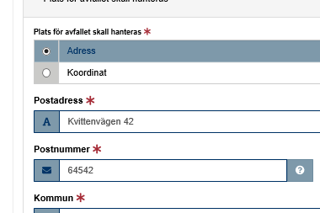
Provide information as a consignee
- Place where the waste was managed last. Option 3 if address is missing - enter municipal code
The municipal code is stated in cases where the municipality manages waste from households or when the producer is unknown, such as dumping.

Slide 17
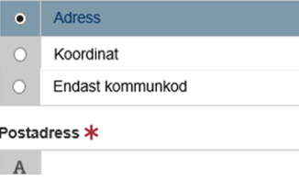
Provide information as a consignee
- Place where the waste will be managed. Option 1 if address exists.
The place where the waste will be managed is where the new holder takes over the responsibility for the hazardous waste
If address is missing, state coordinates or municipality code.

Slide 18
Step 5 waste details

Slide 19
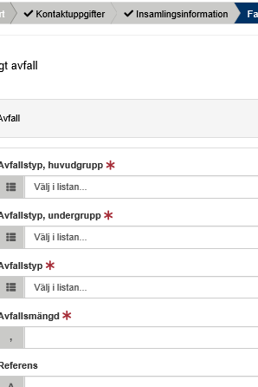
Hazardous waste
All details about the waste must be provided, such as the waste classification code and the amount of waste.
See example on next page.

Slide 20
Example of hazardous waste details
The waste classification codes are from the Waste Regulation (2020: 614) Read an introduction to waste classification
Farligt avfall, avfall Hazardous waste, waste
Avfallstyp, huvudgrupp: * Waste classification code, main group
17 Bygg- och rivningsavfall (även uppgrävda massor från förorenade områden)
Avfallstyp, undergrupp: * Waste classification code, sub group
1706 Isolermaterial och byggmaterial som innehåller asbest
Avfallstyp: * Waste classification code, six digit code
170605 Byggmaterial som innehåller asbest (4)
Here, the waste collector can e.g. enter his/her own code for the waste. Free comment.
Avfallsmängd (kg ):* Amount of waste in kilogram
KG
136
Referens: Reference
Lasse Karlsson

Slide 21
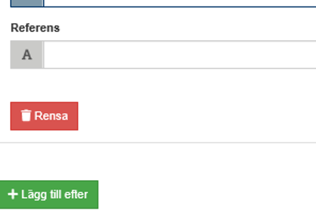
Add more hazardous waste
Select “Lägg till efter“ to add information about other hazardous waste collected at the same time.

Slide 22
Step 6 summary & review

Slide 23
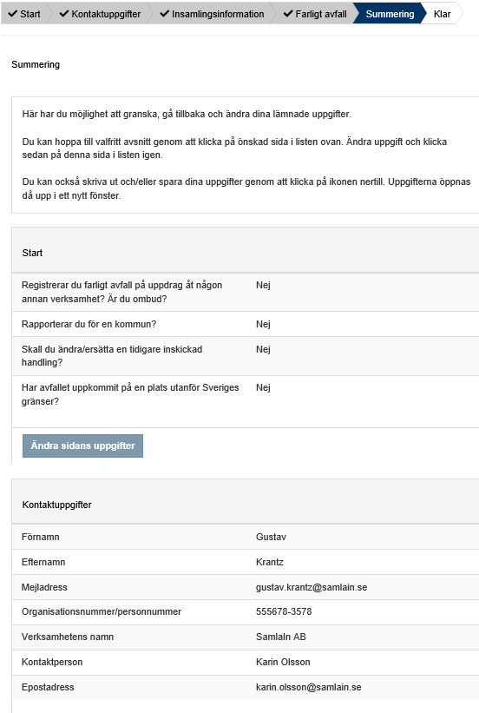
Summary
Review the information.
You can reach different sections to change details by selecting “Ändra sidans uppgifter”.
After changing details in a previous section, you can go directly to this summary.

Slide 24
Step 7 almost done!

Slide 25
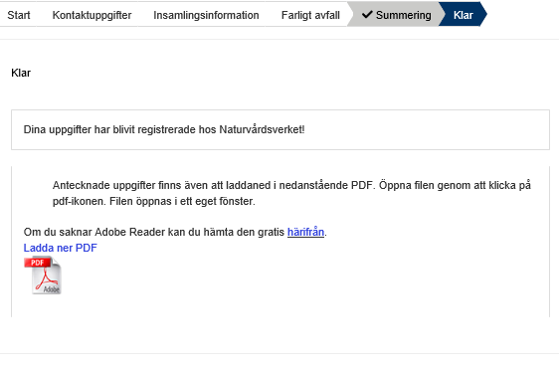
The note is submitted
Thank you for your registration
Keep the registration ID, AvfallsID (found in the pdf file), to be able to revise the registration later.
Log out of the e-service
If your company will dispose your collected hazardous waste later on, you should proceed to the next e-service called “Insamlare - borttransport” (Collector – reporting at removal). Otherwise, you're done by now.

Slide 26
How do I change an earlier registration?

Slide 27
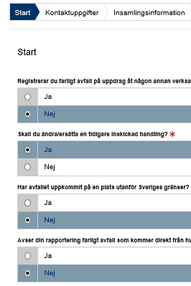
Start
You can edit a submitted note by replacing it. To succeed you need to know the note’s registration ID (avfallsID).
Select “ja“ (yes) at the Start question “Ska du ändra/ersätta en tidigare inskickad handling?”
Enter the former “avfallsID” and enter all correct details
The new note replaces the previous one and gets a new registration ID (avfallsID)
See example on next page.

Slide 28
Example of replacing a previous note
Farligt avfall, avfall Hazardous waste, waste
The waste classification codes are from the Waste Regulation (2020: 614) Read an introduction to waste classification
AvfallsId som ska ändras: * Registration ID to be replaced
055089d1-81c8-4217-9737-aea00685f1f7
Avfallstyp, huvudgrupp: * Waste classification code, main group
08 Avfall från tillverkning, formulering, distribution och användning av ytbeläggningar (färg, lack och porslinsemalj), lim, …
Avfallstyp, undergrupp: * Waste classification code, sub group
0801 Avfall från tillverkning, formulering, distribution, användning och borttagning av färg och lack
Avfallstyp: * Waste classification code, six digit code
080111 Färg- och lackavfall som innehåller organiska lösningsmedel eller andra farliga ämnen
Here, the waste collector can e.g. enter his/her own code for the waste. Free comment.
Avfallsmängd (kg): * Amount of waste in kilogram
KG
100
Referens: Reference
Valfri text

